Slide 1
Nocturna
Group 5
Jack Crawford, Nicolas Frey, Lawrence Lee, Derrick Tong, Roberto Navarijo

Slide 2
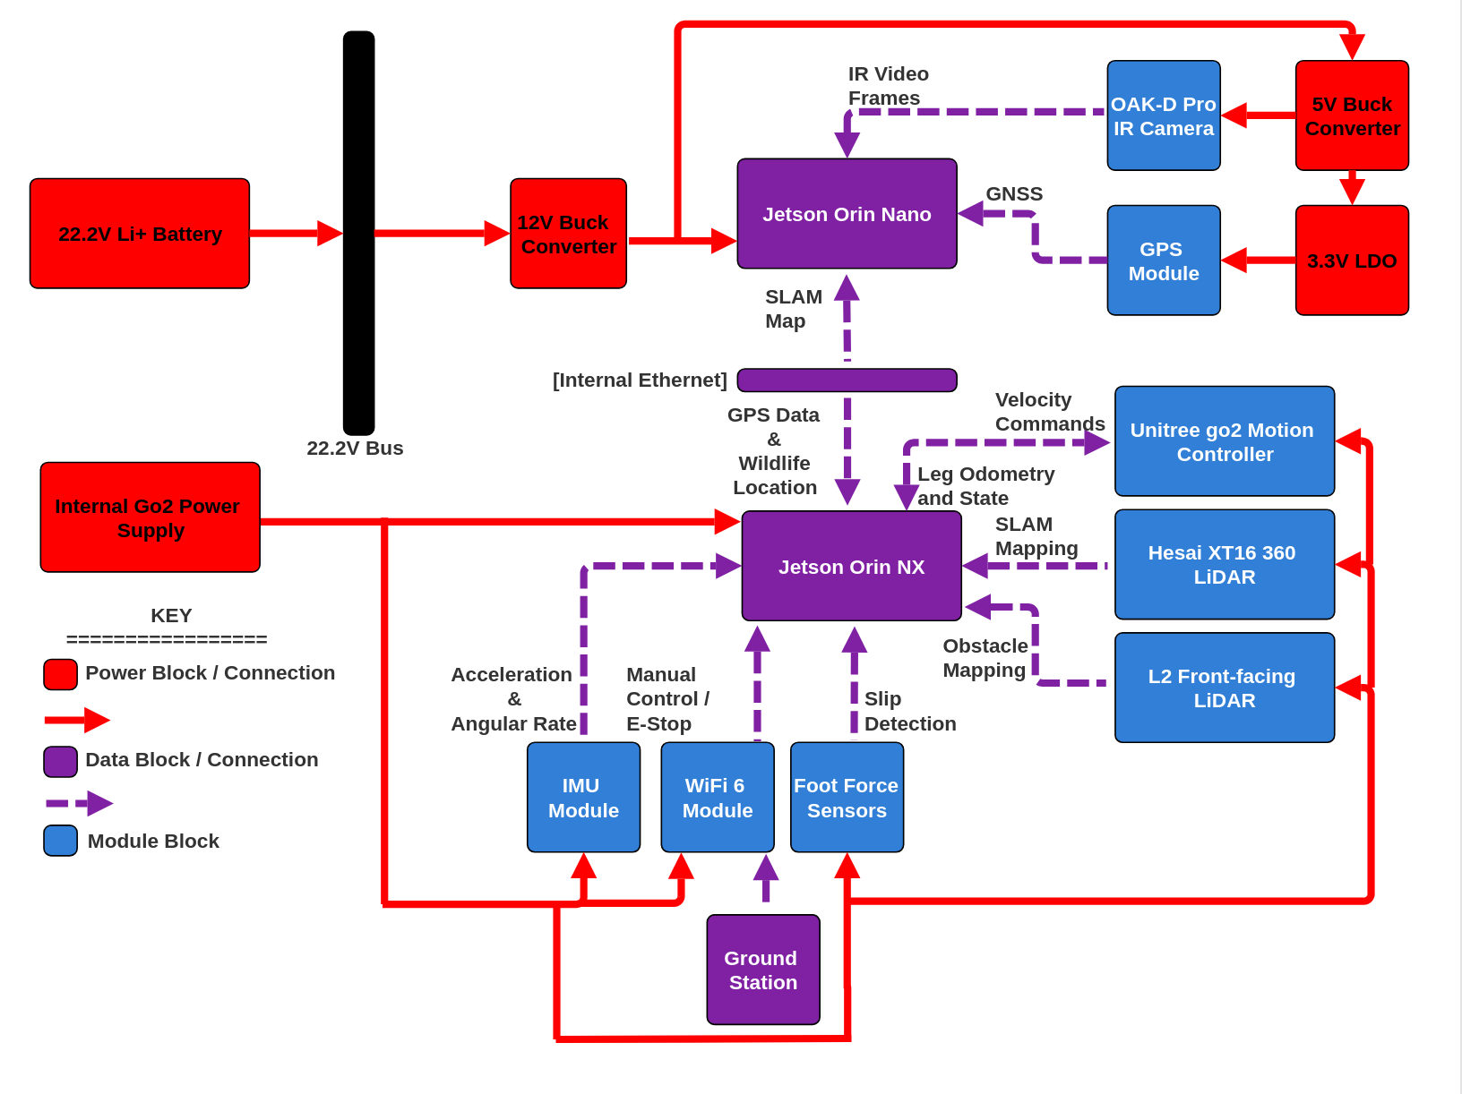

Jack
ROLE
Hardware Design
Navigation (Nav 2)
SLAM (slam_toolbox)
IsaacSim

Slide 3
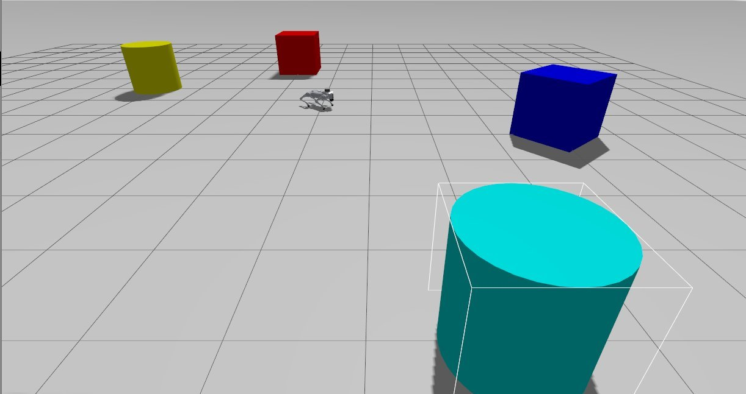
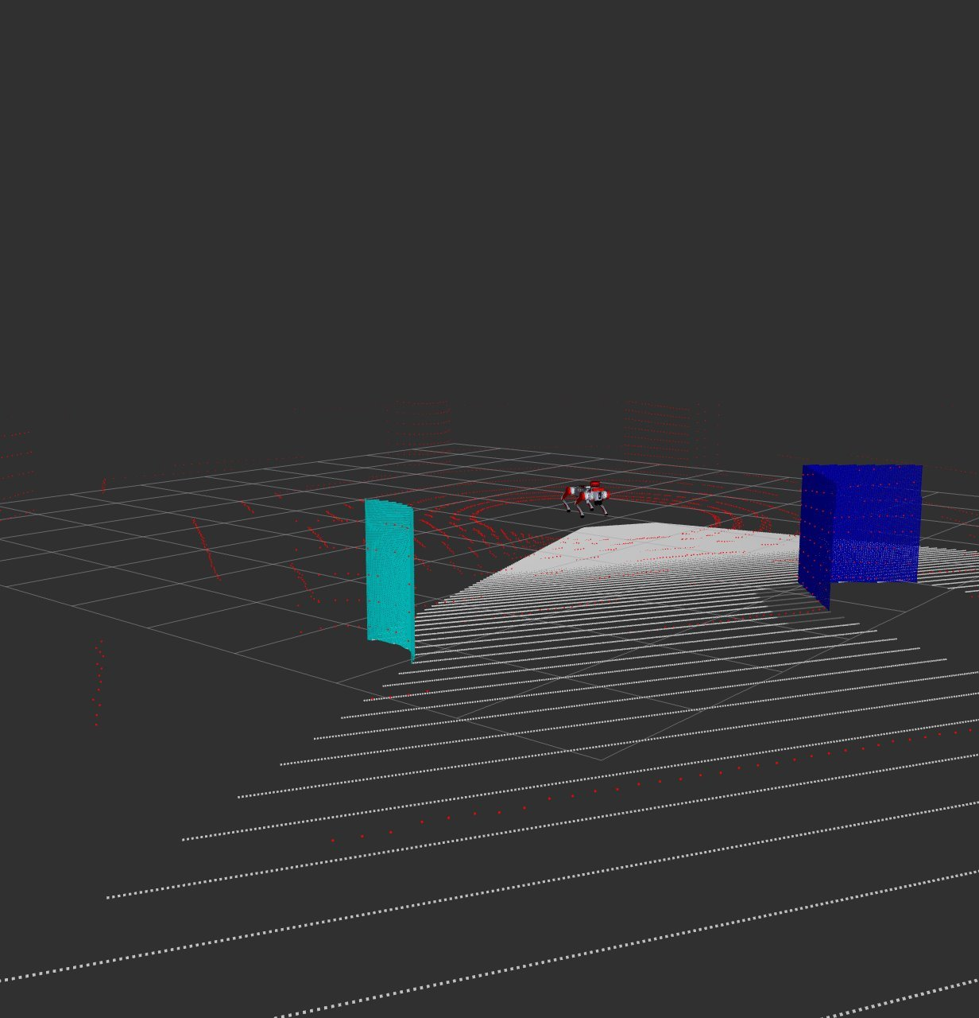
Jack
Work Completed
Hardware Design (75%)
Slam_toolbox (25%)
Nav2 (25%)
IsaacSim (25%)

Slide 4
Jack
Problems:
ROS compatability | ROS bridges and settling on a standard
Nav2 not sufficient | Research GLIM and FAST-LIO2
No realistic maps of outdoors | Manual driving the go2
Learning curve? | More time

Slide 5
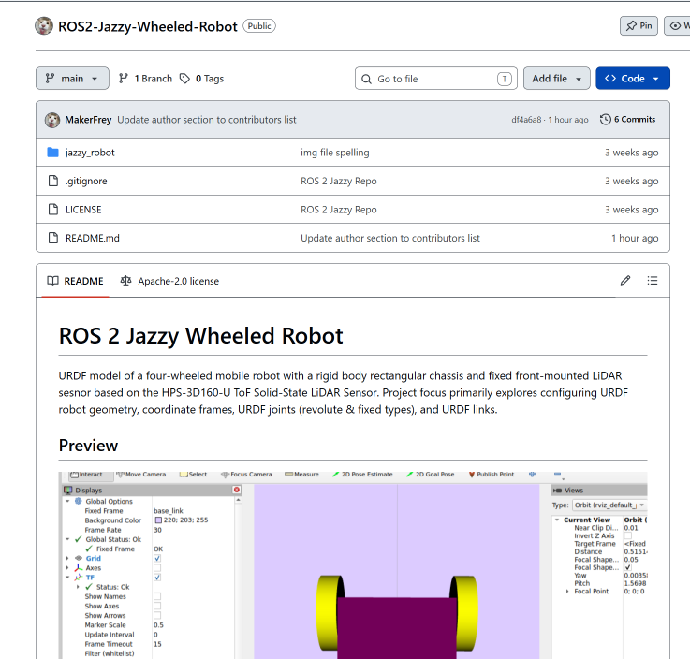
Nick
Role
Roboticist
Systems Integration
Perception Pipeline

Slide 6
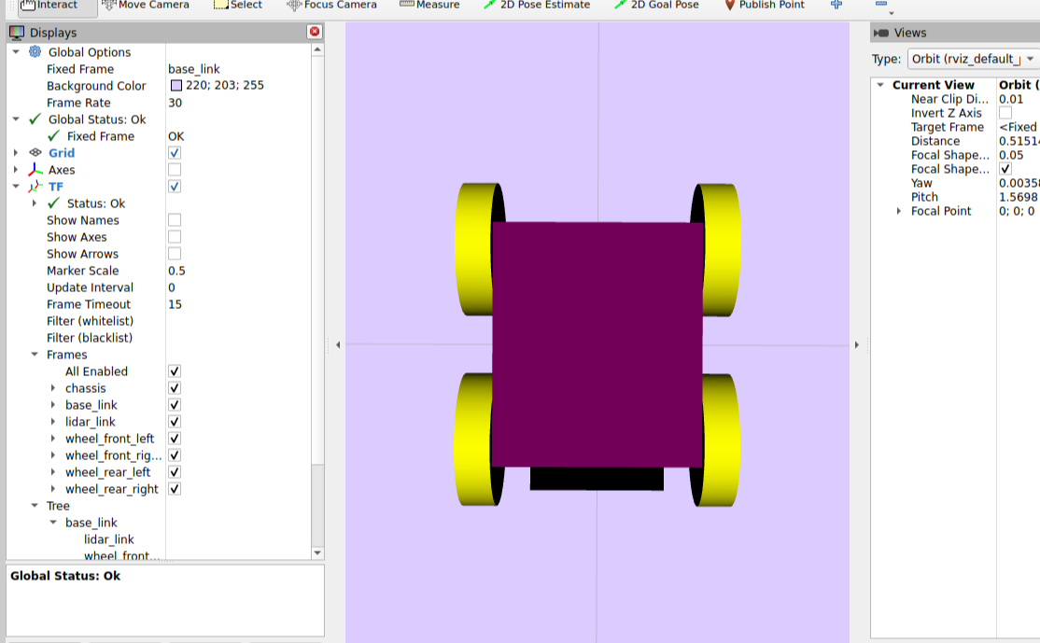
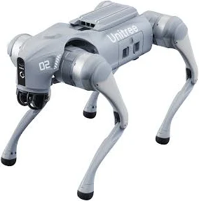
Nick
To-Do
4x4 ~ (%80)
Unitree Go2 (%25)

Slide 7
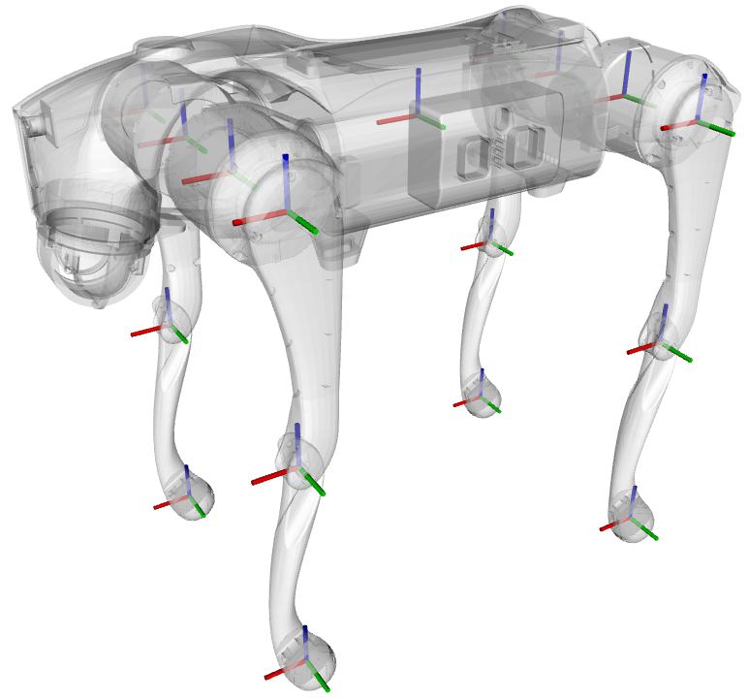
Nick
Next
Controls Model
New Nodes

Slide 8
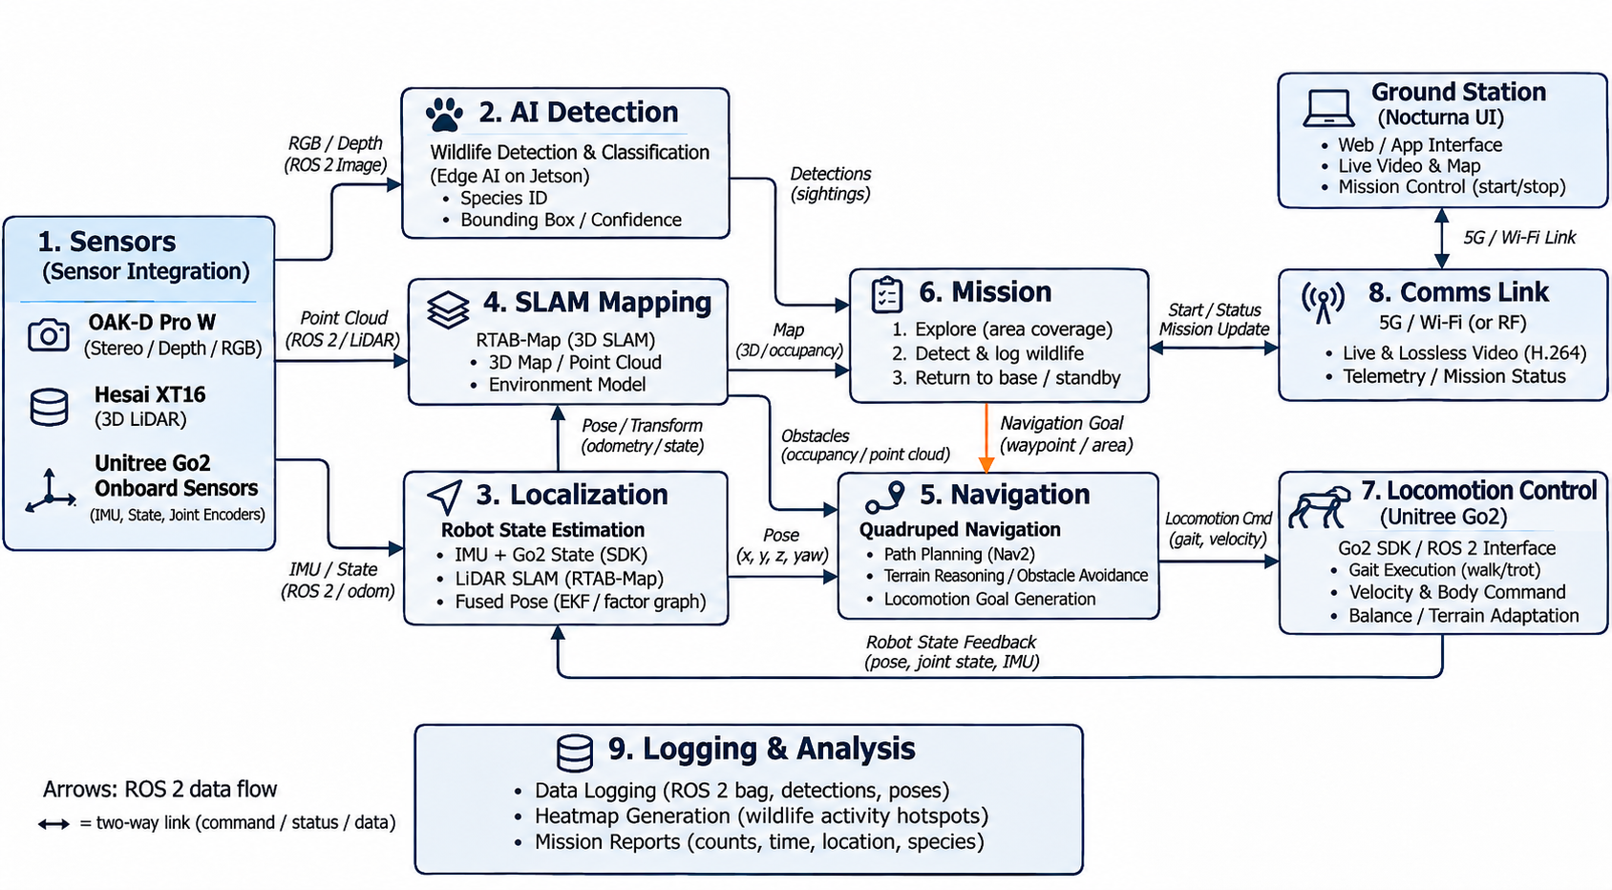



Lawrence Lee: project contribution
My role in project "Nocturna" is system integration engineer. As the system integration engineer, I focus on how the sensors connect to the Unitree Go2 EDU. I am responsible for understanding of how the data is processed and given that information how they would be merged later on. Towards the end of the project the sensor interface documentation, ROS2 configurations, integration diagrams, and sensor validation results will be delivered.

Slide 9
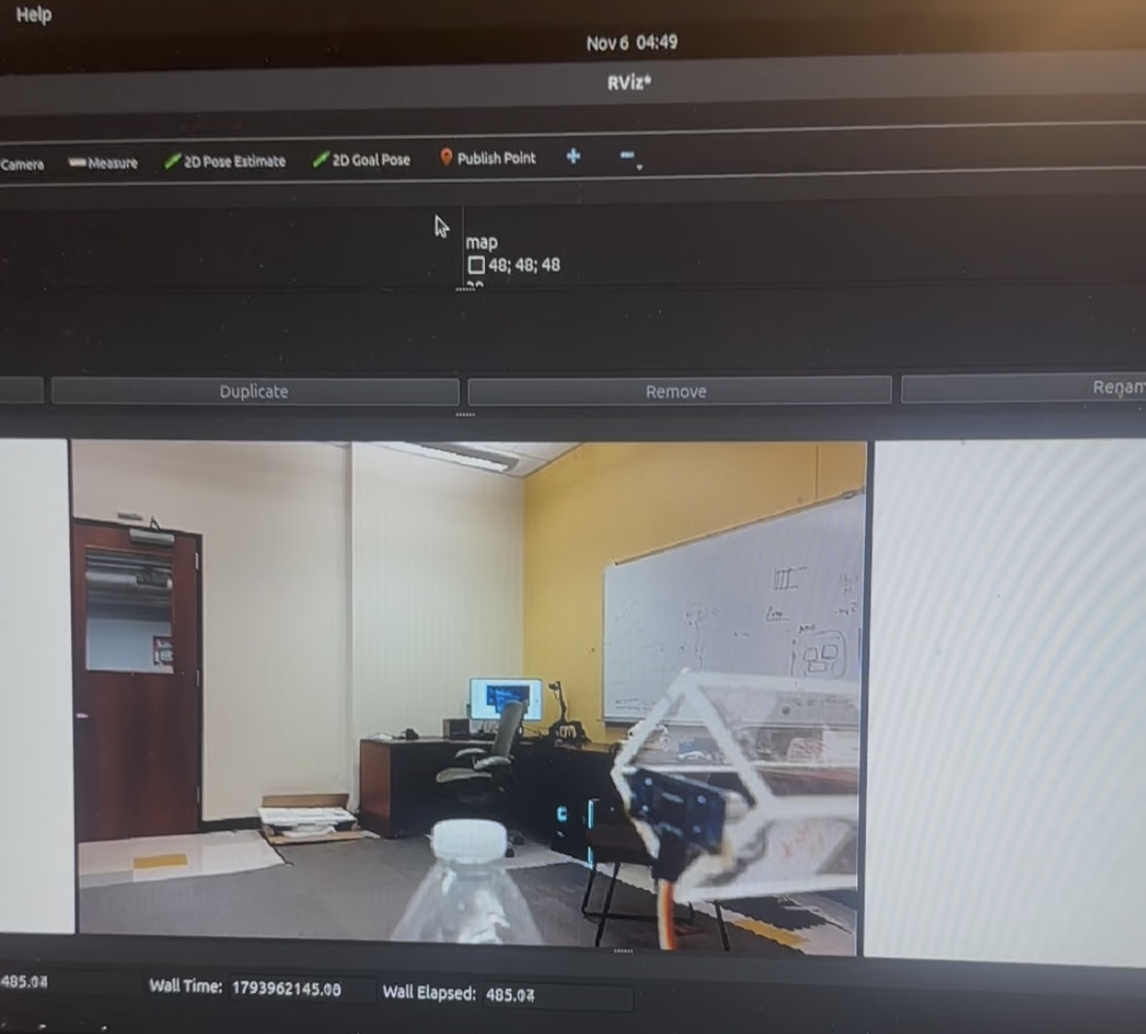
Lawrence Lee: work completed
Tasks to be completed:
Oak D camera connection | Currently in progress (85%)
Camera Image Displayed | Currently in progress (75%)
Depth data displayed | Currently in progress (35%)
Hesai XT16 integration | Not yet started
Wildlife object detection | Not yet started

Slide 10
Lawrence Lee: current obstacles and next steps
The next step going forward is acquiring the actual desired stereo camera, as of now the code written is for a version below the one needed. Although the transition between the two will be seamless as they both use the same packages.
Problems/Obstacles | Solutions
Getting both data outputs of the sensors to synchronize. | ROS 2 data processing and knowing of the timestamps.
Keeping gthe camera connection stable | Troubleshoot USB connectivity and check if using a Virtualbox has any affect.
LiDar Integration | Configure the appropiate He said ROS driver, and verify ethernet communication.
By the end of November I would like to be fully done with the depth data analysts and had begun working on the wildlife detection. And the wildlife detection to be done by early – mid December.

Slide 11
Robert Navarijo: Project Contributions
Project Responsibilities
Major Project Deliverables
1. ROS 2 System Architecture
Modular package design, node communication, and system dependencies.
2. Software Package & Configuration
Organized C++ packages, directory structure, and configuration files.
3. System Launch Framework
ROS 2 launch files for coordinated multi-node execution.
4. Hardware–Software Integration
Integration and validation of Unitree Go2, LiDAR, and camera interfaces.
f
f
Designing the modular ROS 2 software architecture and inter-node communication interfaces
Defining ROS 2 package structure, configuration parameters, and system dependencies
Developing system-wide launch configurations for coordinated node execution
Integrating ROS 2 software modules with Unitree Go2 hardware and onboard sensors
Validating communication between SLAM, autonomy, perception, and data collection modules

Slide 12
Robert Navarijo: Work Completed
Planned Tasks | Status | Description
ROS 2 System Architecture | Preliminary Analysis | Examined individual subsystems and their roles within the overall architecture
Software Package Structure | Preliminary Planning | Identified required ROS 2 packages and their intended functionality
Node Communication Design | Conceptual Understanding | Studied ROS 2 topics, publishers, subscribers, and inter-node communication
System Launch Framework | Not Started | Launch file development and multi-node execution testing remain pending
Hardware-Software Integration | Not Started | Physical integration and testing with the Unitree Go2 and sensors remain pending

Slide 13
Robert Navarijo: Current Obstacles & Next Steps
Technical Obstacles | Proposed Solutions | Target Date
ROS 2 System Architecture | Finalize package organization, node interfaces, and system dependencies | Mid - Late November
Inter-Node Communication | Define ROS 2 topics, message types, and communication protocols between modules | Early December
Simulation Environment | Configure a simulated Unitree Go2 with LiDAR and camera interfaces for integration testing | Early December
System Integration & Validation | Develop launch files and verify coordinated node execution in simulation | Mid – Late December

Slide 14
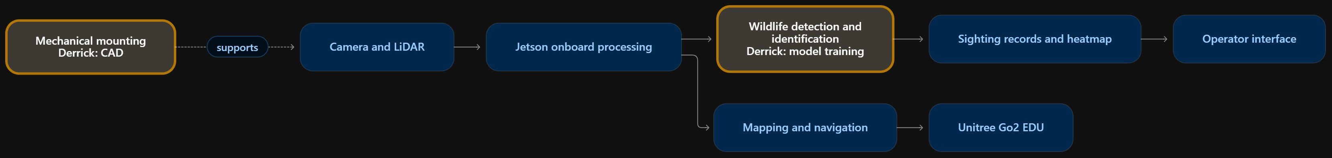
Derrick - Project Contribution
Responsibilities
Develop CAD mounting designs for equipment on the Unitree Go2 EDU.
Develop and train the AI model for wildlife detection and species identification.
Evaluate model performance and prepare it for onboard integration.
Major deliverables
CAD assembly models and dimensioned mounting drawings.
Trained wildlife detection model and evaluation results.
Supporting contributions
Alternative design concepts and interface, user-interface, and ergonomic requirements.

Slide 15
Derrick – Work Completed
Planned Task | Status | Description
Equipment layout | 40% | Arranging the camera, LiDAR, and onboard computer on the Dog while accounting for sensor visibility and component access.
Mounting Assembly Design | 0% | Develop CAD models for mounting brackets and support structures.
Wildlife Dataset Preparation | 50% | Collection and label images of target wildlife species.
AI Model Training | 20% | Fine-tune a pretrained detection model to locate wildlife in images and identify them.
Model Evaluation | 0% | Evaluate predictions on separate test images.

Slide 16
Derrick – Current Obstacles & Next Steps
Technical Obstacles | Proposed Solutions | Target Date
Mounting fit and component clearance need verification | Confirm attachment dimensions on the Dog and revise CAD models to preserve sensor views and cable access | Mid-Late November
Limited labeled Images for target wildlife species | Collect and label additional images, including representative nighttime conditions, and separate training and test data | Late November
AI model training and configuration remain unfinished | Fine-tune the model and adjust training settings based on validation results | Early December
Detection accuracy and onboard performance need evaluation | Review missed detections and species errors | Mid-Late December
Schedule impact: Mounting revisions and dataset preparation may affect integration timing; the delay estimate is not yet determined.

